Slide 1

Ethiopia's Performance-Based Investment Incentives
Legal Insight on Regulation No. 586/2026 | DABLO Law Firm
March 2026

Slide 2
A Fundamental Shift in Investment Strategy
●
Performance-based model requires investors to meet specific targets for job creation, technology transfer, and export performance through legally binding agreements with the Ethiopian Investment Commission
●
Reduced corporate tax rates from 5% to 15% for up to 10 years, representing 50-83% reduction from standard 30% rate, with complete customs duty exemptions on capital goods and construction materials
●
USD 10 million minimum capital investment threshold ensures incentives target transformative projects capable of generating significant employment, foreign exchange earnings, and technological advancement
●
Focus on priority sectors including manufacturing, renewable energy, agro-processing, mining value-addition, and technology ecosystems positions Ethiopia as competitive destination for capital-intensive investments

Slide 3
Strategic Rationale Behind the Reform
International Standards
Regulation No. 586/2026 represents Ethiopia's commitment to result-oriented investment promotion aligned with international fiscal transparency standards
Align with OECD guidelines on fiscal transparency and responsible tax competition
10-Year Benefit Period
Accountability
Ensure measurable targets through continuous monitoring and performance verification
Capital-Intensive Focus
Performance Accountability
Selectivity
Conditionality ensures benefits flow only to investors demonstrating measurable performance through employment creation, technology transfer, and export commitments
USD 10 million threshold targets transformative investments with economic spillovers
Transparency requirements mandate annual tax returns, audited financial statements, and performance reports, enhancing fiscal accountability and international credibility
Conditionality
Incentives are earned privileges requiring continuous compliance, not automatic entitlements
Framework supports Ethiopia's Homegrown Economic Reform agenda and SDG commitments, particularly clean energy, decent work, and industry innovation

Slide 4
Tax Incentive Structure
SEZ developers benefit from 5% corporate tax for 10 years, an 83% reduction from standard 30% rate.
Technology start-ups receive 5% corporate tax plus dividend tax exemption for 5 years.
Priority sector investors qualify for 15% corporate income tax for up to 10 years.
Incentive period begins upon business license issuance, ensuring benefits flow to operational projects only.
5%
Tax for SEZ & Start-Ups
15%
Tax Priority Sectors
10 Years
Maximum Duration
.

Slide 5
Comprehensive Customs and VAT Exemptions
Eligible for Duty Exemption
100%
Machinery, equipment, and industrial tools directly used in production or service delivery including technology-intensive assets, construction materials for factories and warehouses, replacement parts subject to quantity limits, and raw materials for SEZ enterprises.
Duty Exemption on Capital Goods
Local Sourcing Equivalence
Phased
Investors purchasing capital goods from Ethiopian manufacturers receive refunds of embedded import duties, maintaining level playing field between imported and locally-produced equipment while promoting domestic manufacturing development.
Import Allowance
Compliance and Controls
Duty-exempt goods subject to rigorous tracking with Customs Commission and Ethiopian Investment Commission conducting periodic inspections to verify usage as declared.
Transfer and Re-Export Rules
Duty-free goods can only be transferred to another eligible investor or sold domestically upon payment of foregone duties plus interest, while re-exportation permitted without duty payment, with misuse triggering duty payment, penalties, and potential complete revocation of all incentives.

Slide 6
Eligibility: Priority Sectors and Capital Requirements
Foreign investors must engage in priority investment areas designated in Table 1 of the regulation with USD 10 million minimum capital investment
$10M Minimum Investment
Value Addition Required
Advanced manufacturing encompasses import-substitution industries, agro-processing, pharmaceutical production, and automotive components with significant local value chain development potential
Renewable energy projects include solar, wind, geothermal, biomass initiatives, energy storage systems, and carbon credit trading aligned with Ethiopia's SDG 7 commitments for clean energy
ICT and innovation covers technology parks, software development, business process outsourcing, and start-up ecosystems positioning Ethiopia as competitive African tech hub alongside Kenya, Rwanda, and South Africa
Projects must demonstrate additional production capacity or value addition ensuring new economic activity rather than mere relocation of existing operations, with excluded activities including raw mining extraction, domestic trading, general services, and cryptocurrency mining

Slide 7
Performance Agreements: The Cornerstone of Accountability
Quarterly/Annual Reporting Required
Automatic Suspension for Non-Filing
Full Revocation Possible
Employment creation targets specify number of Ethiopian nationals employed with full-time equivalents, women's employment, training programs, and employment milestone timeframes
Technology transfer commitments include knowledge transfer through training programs, localization of technical positions, R&D commitments, and partnerships with Ethiopian educational institutions
Production targets cover production volume and quality standards, export commitments, value chain development contributions, and utilization of local raw materials
Environmental and social responsibility measures include sustainability commitments, CSR initiatives, and community development programs with Ethiopian Investment Commission conducting periodic reviews

Slide 8
Compliance Requirements and Consequences
Annual Filing
Tax returns, audited financial statements, and performance reports filed every year
EIC Review
Ethiopian Investment Commission shares performance data with Ministry of Finance, Tax Authority, and Customs Commission for cross-verification, ensuring comprehensive inter-agency coordination [1]
Investors must maintain segregated accounting for incentivized activities from project inception to facilitate annual reporting and compliance verification with quarterly tracking systems recommended
Performance Agreements should include realistic projections based on conservative business forecasts with built-in flexibility for market volatility, economic conditions, and periodic review mechanisms
Recommended to include arbitration or mediation clauses for disagreements over performance compliance, with provisions for target recalibration based on force majeure events [1]
Ethiopian Investment Commission conducts periodic performance reviews
Automatic Suspension
Failure to file required documents results in loss of incentive for that year
Material Non-Compliance
Triggers complete revocation requiring repayment of foregone taxes from beginning
Remedial Relief
Ministry of Finance may provide relief for force majeure or circumstances beyond control

Slide 9
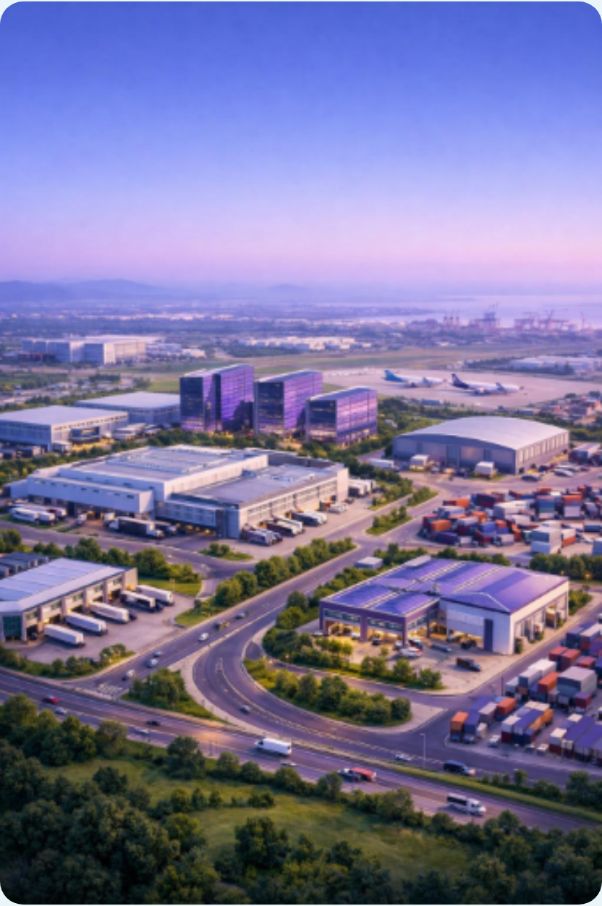
Special Economic Zones: Premier Investment Route
5% Tax Rate
100%
Foreign Currency
for 10 Years [1]
Customs & VAT Exemption [1]
Accounts Allowed [1]
SEZ enterprises benefit from streamlined customs procedures for imports and exports, single-window centralized processing of permits, licenses, and approvals, reducing bureaucratic complexity and processing time [1]
Foreign exchange flexibility allows SEZ enterprises to maintain foreign currency accounts and conduct hard currency transactions, critical advantage for export-oriented manufacturers managing international supplier payments
Established SEZs include Dire Dawa Industrial Park for textiles and garments, Mekelle SEZ for leather products, Kilinto SEZ for pharmaceuticals and medical devices, and flagship Hawassa Industrial Park for textiles and apparel [1]
SEZ locations provide mature infrastructure with reliable utilities, proximity to export logistics hubs, preferential land lease rates, and extended lease periods offering complete operational ecosystem for foreign investors

Slide 10
Technology Start-Ups: Ethiopia's Innovation Frontier
Compete with Kenya, Rwanda, South Africa as African tech hub with 120+ million consumer market.
Ministry of Finance directives define eligibility: innovation-focused models, tech-based products, high growth potential.
Access to technology parks and subsidized incubators provide comprehensive ecosystem for scaling operations.
Capital gains exemption significantly enhances venture capital attractiveness and investor repatriation benefits.

Slide 11
Strategic Recommendations for Foreign Investors
Compliance Infrastructure
Segregated Accounting from Day One
Quarterly Performance Tracking
Implement quarterly tracking systems to monitor employment, production, and environmental metrics in real-time
Conduct annual third-party audits of Performance Agreement compliance to preempt regulatory findings
Pre-Investment Planning
Long-Term Tax Planning
Verify sectoral fit within priority sectors, consulting Ethiopian Investment Commission for emerging sub-sectors
Structure capital to meet USD 10 million threshold through related projects or phased deployment
Prepare for transition to 30% standard rate by optimizing depreciation schedules and exploring reinvestment allowances [1]
Ensure arm's length pricing on intra-group transactions to avoid transfer pricing adjustments [1]
Performance Agreement Negotiation
Include provisions for target recalibration if macroeconomic conditions change, like currency devaluation
Structure targets with annual milestones rather than single end-of-period assessment

Slide 12
Ethiopia's Value Proposition for Serious Investors
120M+
Consumer Market Population [1]
10 Years
$10M
5-15%
Reduced Tax Benefit Period [1]
Minimum Investment Threshold [1]
Corporate Tax Rates vs 30% Standard [1]
Regulation No. 586/2026 ensures serious, well-capitalized foreign investors receive decade-long fiscal support in exchange for delivering measurable economic impact through job creation, technology transfer, and export performance
Suited for large manufacturers, renewable energy developers, technology companies, and agribusiness corporations with export capacity
Strategic Horn of Africa location with preferential market access and Everything But Arms programs
Decade of reduced tax rates provides predictable fiscal environment ideal for capital-intensive undertakings with sustained investment commitments

Slide 13
About DABLO Law Firm
Highly Ranked
Chambers and Partners
Lex Africa Alliance
Member with Pan-African Legal Team
Leading Law Firm
Legal 500
Leading full-service law firm based in Ethiopia with proven track record helping clients navigate legal and regulatory landscape across investments, banking and financial services, capital markets, corporate and commercial law, and fintech sectors
Part of Lex Africa, the first and largest African legal alliance with Pan-African legal team of more than 600 lawyers in 33 countries providing seamless cross-border and local African legal solutions, consistently ranked Band 1 Leading Regional Law Firm Network by Chambers and Partners
Extensive expertise guiding local and international investors through every stage of investment journey from market entry and business setup to licensing, structuring, and compliance aligned with Investment Proclamation No. 1180/2020
For Investment Legal Guidance:
Contact DABLO Law Firm Investment & Tax Practice at info@dablolawfirm.com or +251938888887

